Slide 1
Cool Stones

Slide 2
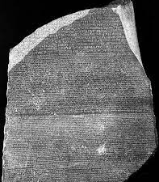
Number 1 Rosetta Stone

Slide 3
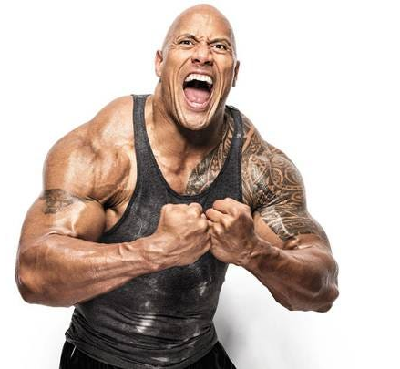
Number 2 The Rock

Slide 4
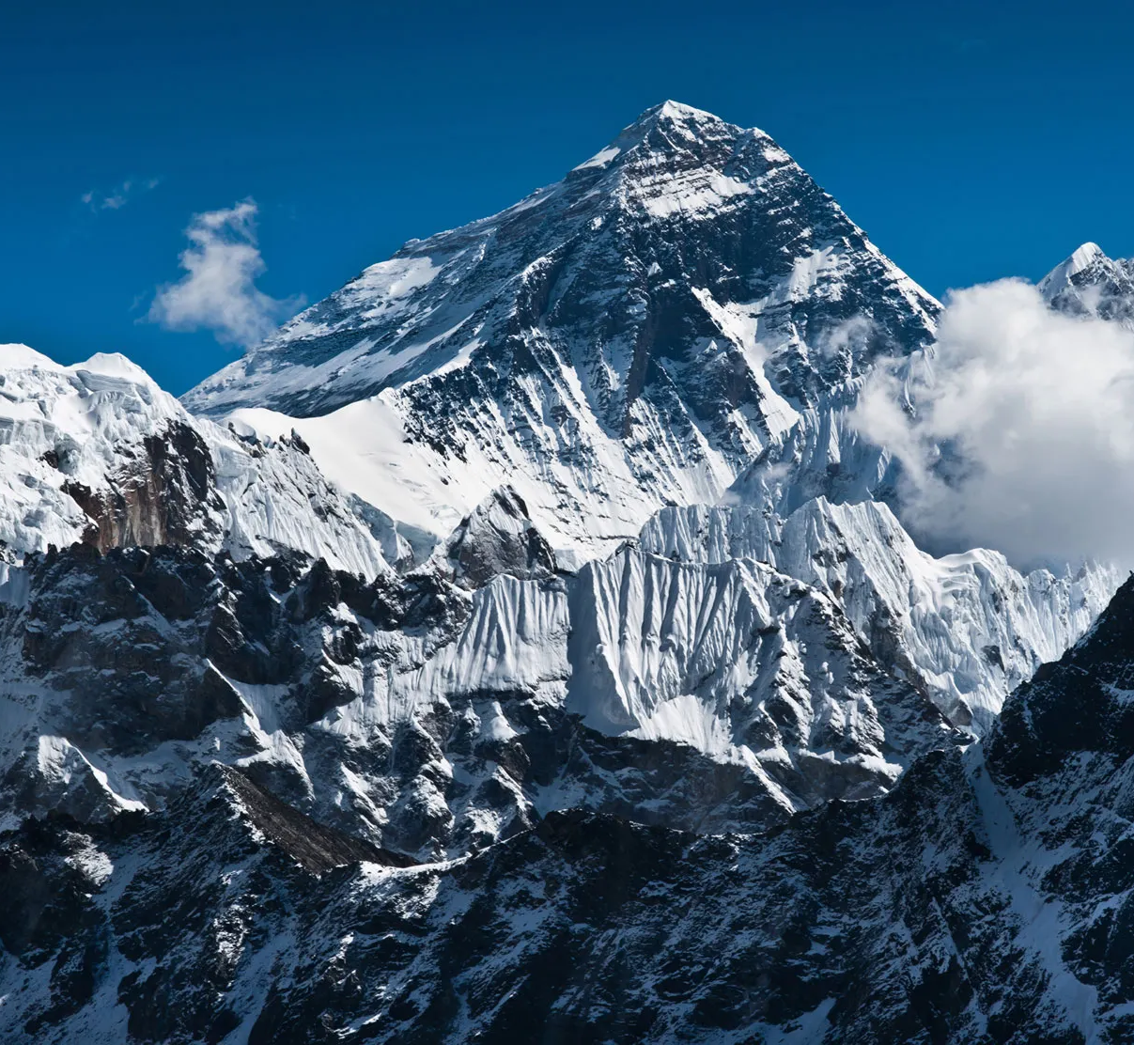
Number 3 Mount Everest (Big Stone)

